Slide 1
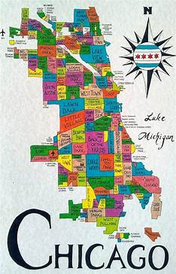

CHICAGO CRIME ANALYSIS
B VIGNESH 04-09-2024

Slide 2

ABOUT CHICAGO CRIME
Crime Challenges and Hotspots: Chicago struggles with high crime rates, especially in areas like Austin, Garfield Park, and Englewood, where violence and gang activity are prevalent. Gun violence, including homicides and shootings, remains a significant concern.
Strategies and Interventions: The city has implemented various strategies to combat crime, such as increasing police presence, community engagement, and crime prevention programs. Initiatives like Operation Legend have focused on reducing violent crime through federal and local collaboration.
Socio-Economic Barriers: Despite these efforts, ongoing socio-economic issues, such as poverty and limited opportunities, continue to drive crime in many neighborhoods, making it challenging to achieve lasting improvements.

Slide 3

DATA OVERVIEW
Identification and Classification: Each crime incident is uniquely identified by an ID and Case Number, with details categorized using IUCR codes, crime types, and descriptions for clear classification.
Location and Time Details: The dataset provides spatial information (Block, Beat, District, Ward, Community Area, and coordinates) and temporal details (Date, Year), supporting detailed spatial-temporal analysis of crime incidents.
Crime Context and Flags: The dataset includes context information such as Location Description and flags indicating whether the crime involved an arrest or was domestic-related.
Geographical Coordinates and Updates: X and Y coordinates, along with latitude and longitude data, allow for precise crime mapping across Chicago, while the "Updated On" field tracks the latest updates to each record, aiding in monitoring case progress or closure.

Slide 4

PROBLEM STATEMENT
A year ago in Chicago, the high incidence of crime prompted the government to take decisive action by launching an operation with top-performing police officers. Now, as a year has passed since this decision, the government seeks to evaluate the reduction in crime cases and the advantages gained from this new operation. The government has engaged you as a freelancer data analyst to analyze the changes and improvements in crime rates. The government is seeking the following objectives from your analysis: 1. If the case solving time improved 2.What are the localities where the crime rate were higher 3.What can be the measures that can be taken in order to keep the crime rate in control moving further

Slide 5
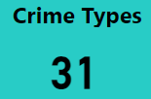
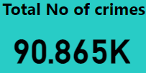
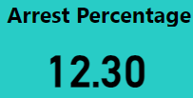
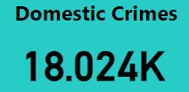
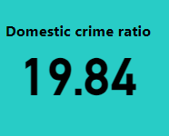
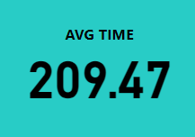
KEY DATA POINTS
Total Number of different crime types
Total Number of crimes in this dataset
Arrest Percentage
Total Number of Domestic crime in this dataset
Domestic crime proportional Analysis
Average time taken

Slide 6
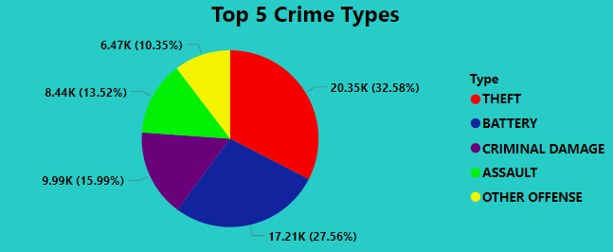
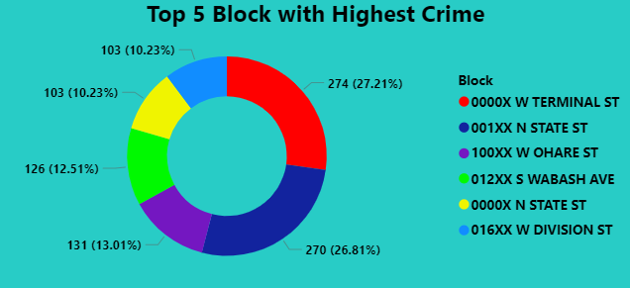
TOP FIVE CRIME TYPES
TOP FIVE BLOCK WITH HIGHEST CRIME

Slide 7
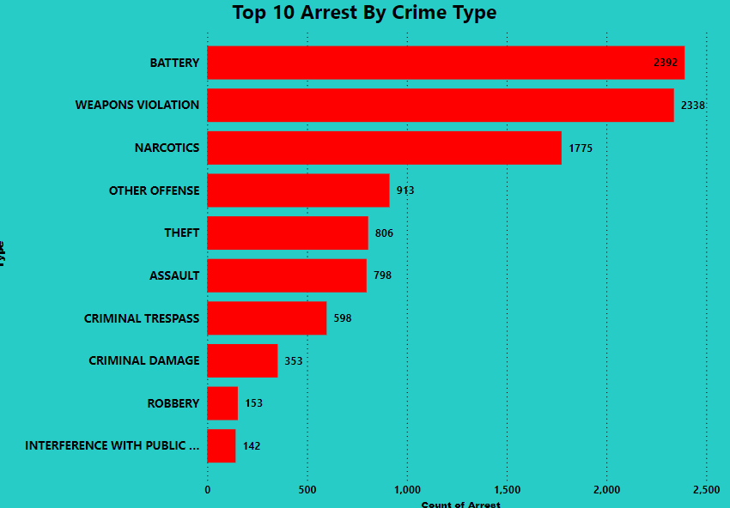
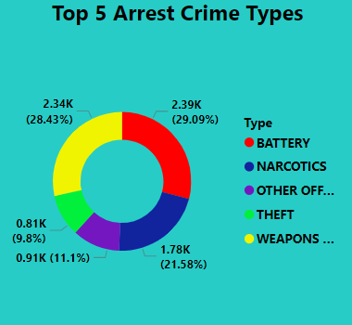
TOP TEN ARREST BY CRIME TYPE
TOP FIVE ARREST CRIME TYPES

Slide 8
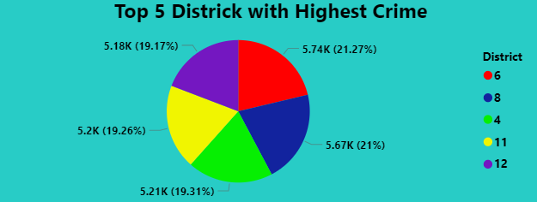
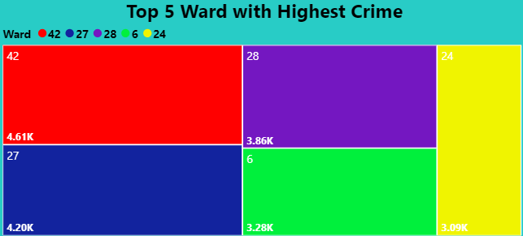
TOP FIVE DISTRICT WITH HIGHEST CRIME
TOP FIVE WARD WITH HIGHEST CRIME

Slide 9

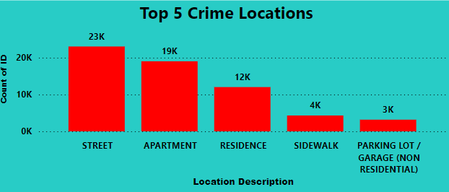
CRIME LOCATIONS
TOP FIVE CRIME LOCATIONS

Slide 10
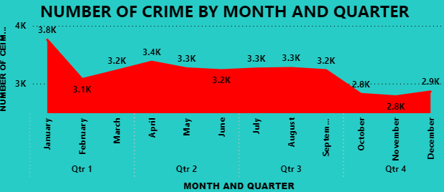
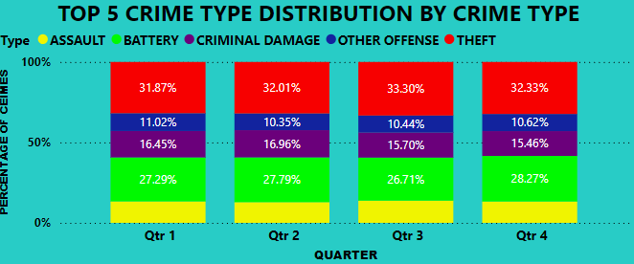
NUMBER OF CRIME BY MONTH AND QUARTER WISE
TOP FIVE CRIME TYPE DISTRIBUTION BY CRIME TYPE

Slide 11

STEPS TO REDUCE CRIMES
Community Engagement and Awareness: Boost community vigilance by educating residents, enhancing neighborhood watch programs, and promoting beautification efforts to foster responsibility and a safer environment.
Enhanced Security and Surveillance: Improve lighting, install more CCTV cameras, and implement secure entry systems in high-risk areas such as streets and apartment complexes, along with increased police presence in crime hotspots.
Strengthen Support and Enforcement: Provide support for domestic violence victims, implement conflict resolution and anger management programs, and enforce stricter penalties for repeat offenders to enhance safety and reduce crime recurrence.

Slide 12
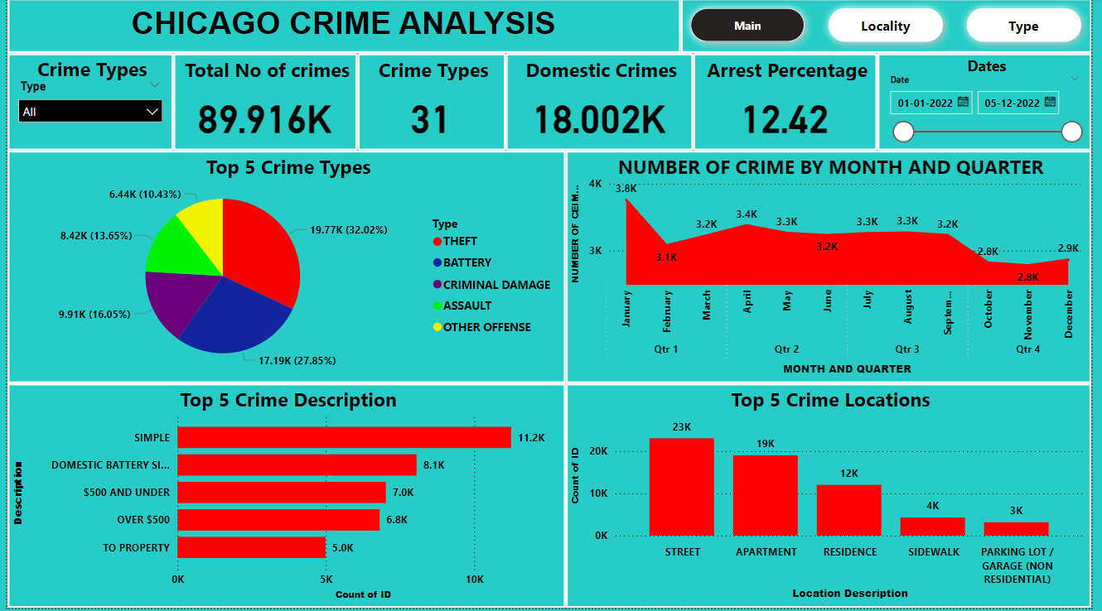
MAIN DASHBOARD

Slide 13
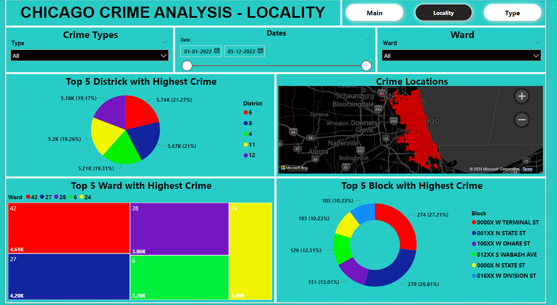
LOCALITY DASHBOARD

Slide 14
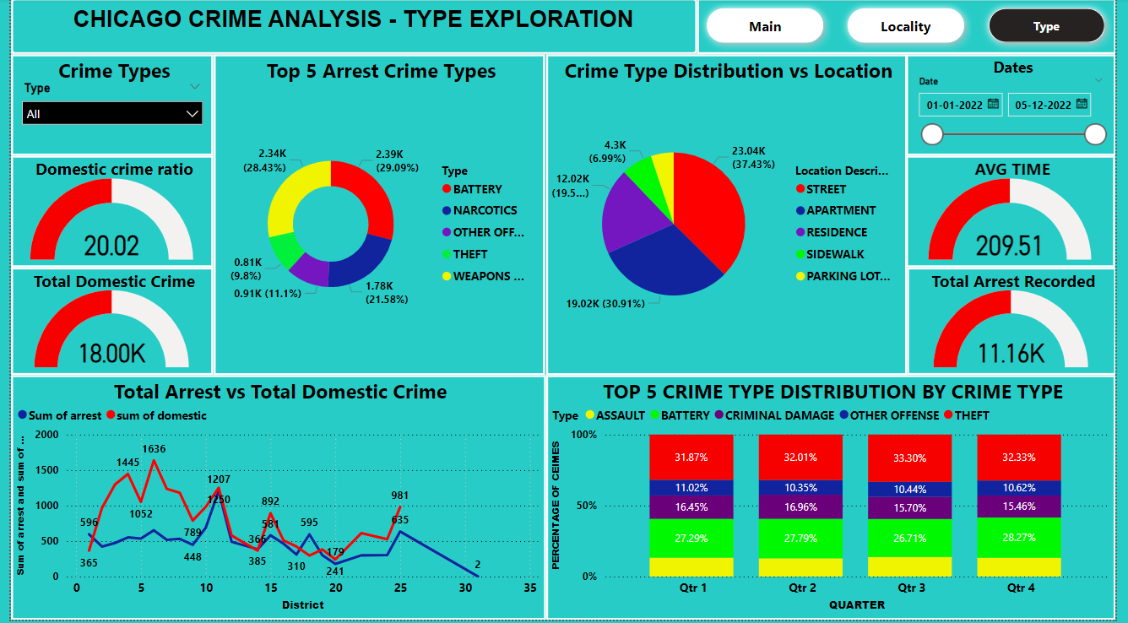
TYPE EXPLORATION DASHBOARD

Slide 15

CONCLUSION
Theft and Battery Prevention: With theft (20,348 incidents) and battery (17,211 incidents) being the most common crimes, enhancing surveillance, police presence, community awareness, and security systems in high-risk areas are key measures to reduce these crimes.
High-Risk Locations: Street-level crimes, apartments, and residences are hotspots. Targeted interventions like better lighting, CCTV, and security patrols in these areas can significantly lower crime rates.
Community and Ongoing Evaluation: Strengthening neighborhood watch programs, public education on safety, and continuous monitoring of case-solving efficiency are crucial for maintaining long-term crime reduction.

